Slide 1



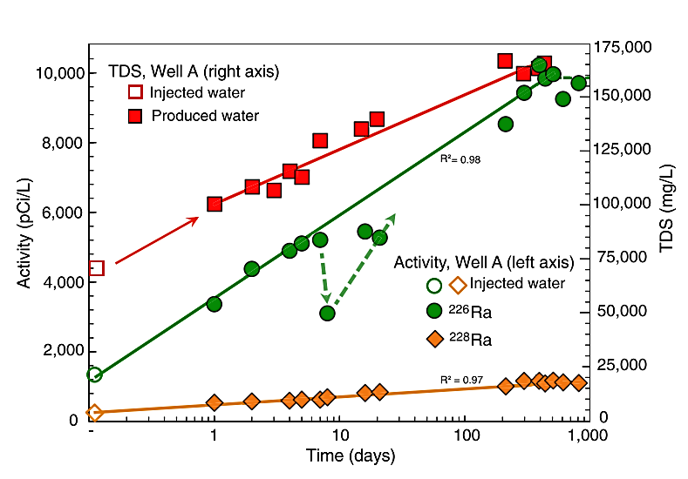
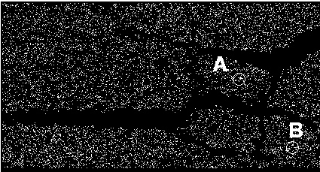
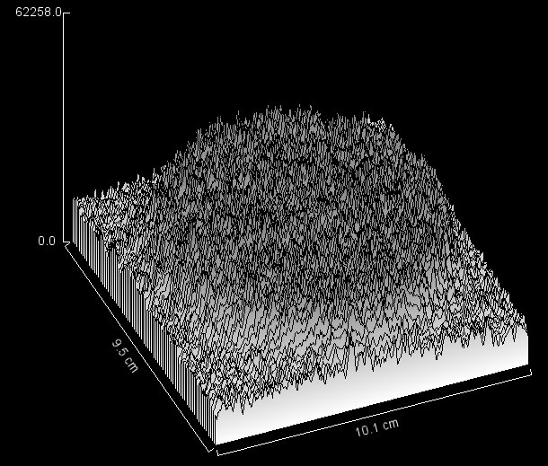
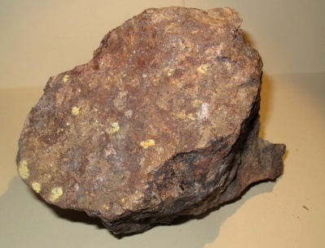
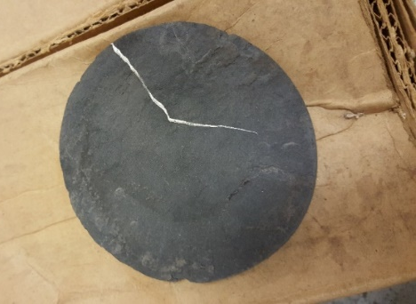
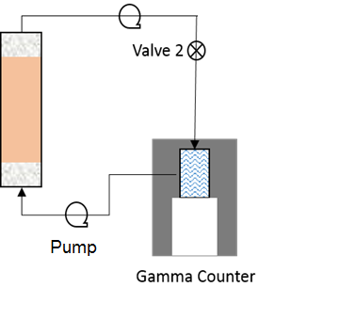
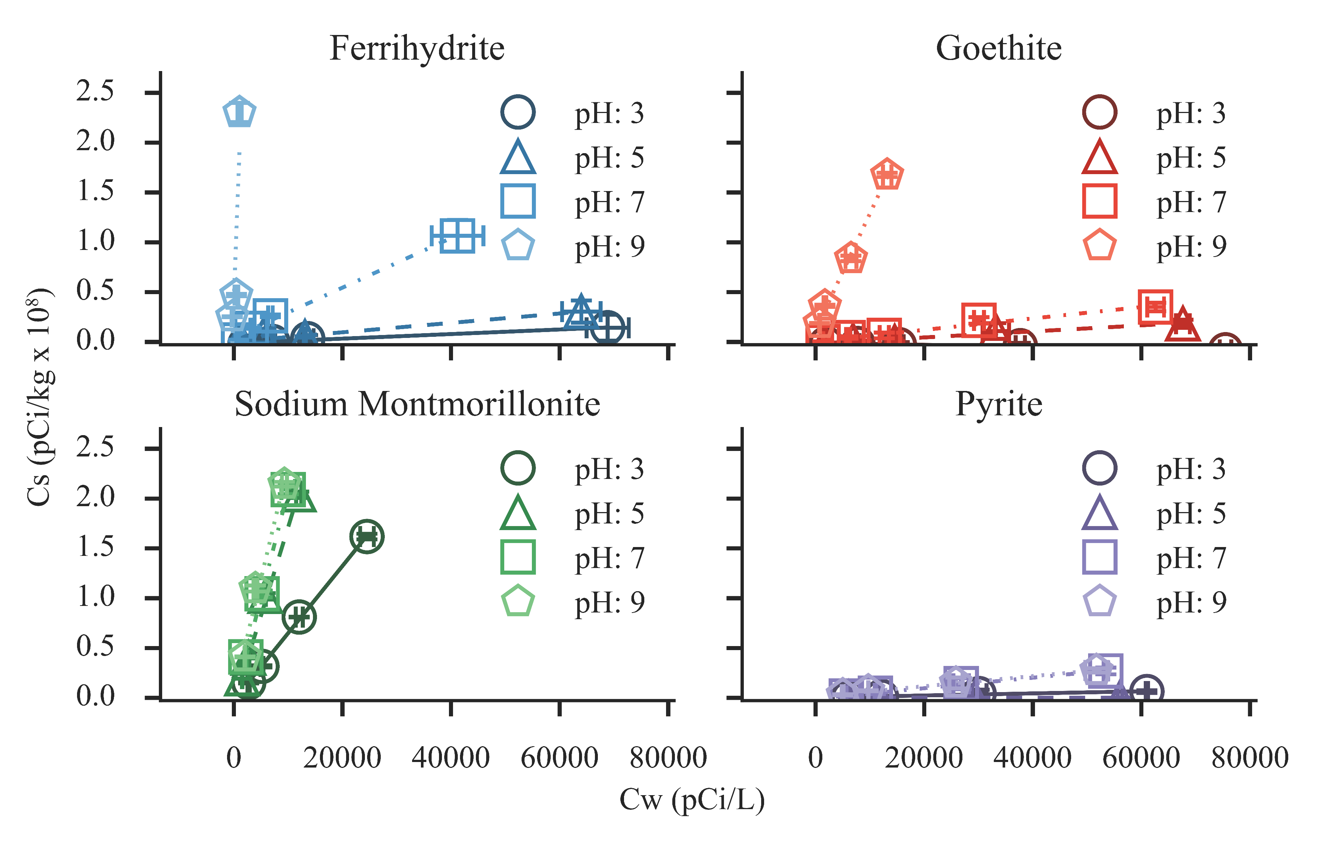
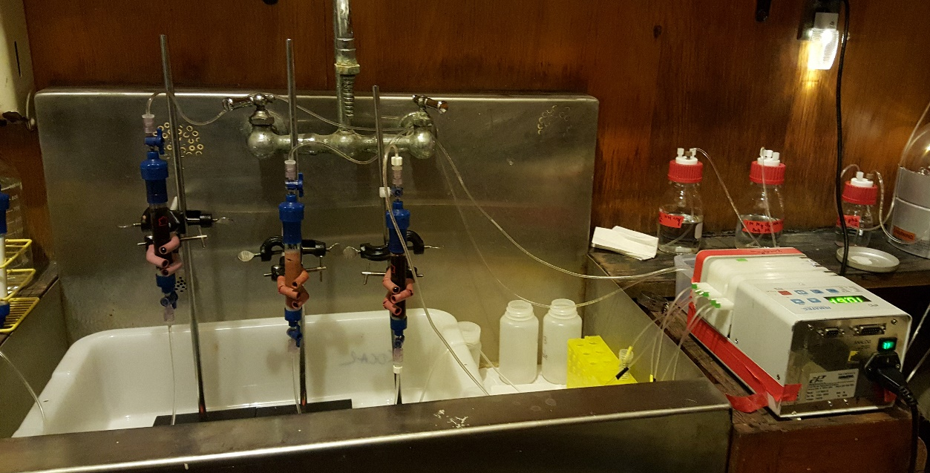
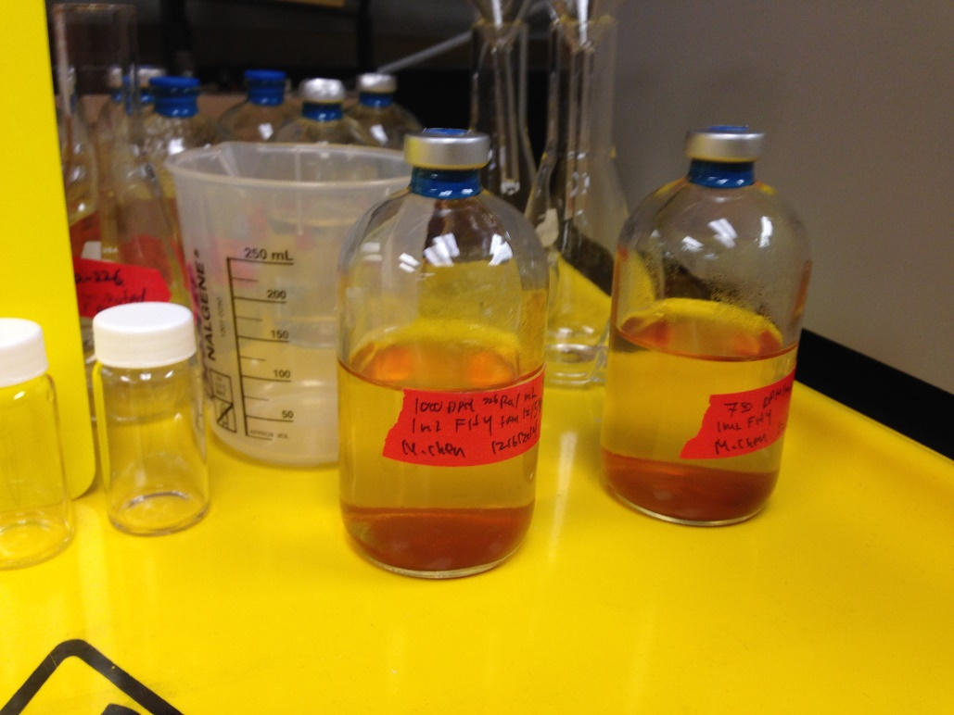

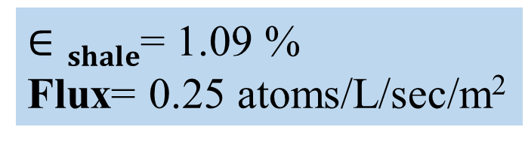
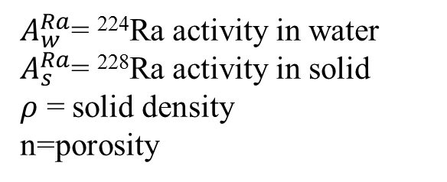
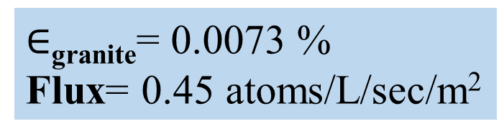



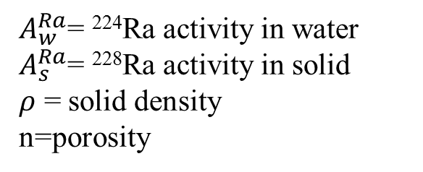
In-Situ and Above-Ground Chemical Oxidation Strategies for Treating Hazardous Flowback Water Generated from Hydraulic Fracturing:
Mineralogical mechanisms controlling radium retention and release
Neha Mehta, Michael Chen, Charles Harvey, Benjamin D Kocar
Civil and Environmental Engineering, Massachusetts Institute of Technology | Email: kocar@mit.edu
introduction
Rock characterization
EPA drinking water regulatory limit for combined 226Ra and 228Ra is 5 pCi/L and for effluent discharge stream is 60 pCi/L
µXRF study of Uranium in Shale
A
B
Electron Microprobe analysis of Granite
Autoradiograph -Shale
$$20μm$$
$$20μm$$
Sequential Extraction of Shale
Flowback and produced water (referred to as flowback water) resulting from hydraulic fracturing contains a complex milieu of anthropogenic and natural chemical constituents including naturally occurring toxic inorganic elements such as strontium, barium and naturally occurring radioactive materials such as ²²⁶Radium. Typical produced water concentrations of ²²⁶Ra range from 3-10,000 pCi/L, often exceeding the EPA drinking water standard of 5 pCi/L. Radium isotopes are naturally sourced to solution by radioactive decay of the parent products uranium and thorium, where alpha recoil liberates Ra isotopes from aquifer solids. They then accumulate until they are removed by hydrologic flushing or they reach secular equilibrium with the parent isotopes. Once in solution, Ra isotope transport is primarily controlled by sorption to mineral and organic surfaces. To date, there is minimal study of alpha recoil processes that source Ra to solution, nor a comprehensive model of Ra sorption to minerals typically found in the highly saline, anoxic formations. Prediction of these two critical processes will enable the development of methods to reduce or retard Ra associated with flowback and produced water. Here we present experimental studies of these two Ra processes, alpha recoil and mineral sorption. We present measurements of Ra alpha recoil fluxes from shale samples in the Marcellus formation, as well as measurements of Ra sorption to key mineral phases found in deep formations. These results suggest that geochemical disturbances associated with hydraulic fracturing injections may drive enhanced release of Ra, but minimization of those disturbances can reduce the total hazard of flowback and produced water.
Uranium is uniformly dispersed in shale with a few localized hot spots at micro scale
Uranium in shale is present in large fraction in primary and secondary mineral phases
Unlike Shale, Granite has Uranium heterogeneously distributed in the rock
Previously reported data on Granite mineralogy indicates uranium present as Uraninite, USiO₄ etc. in Granite
RESULTS
$∈$_{granite}= 0.0073 %
Flux= 0.45 atoms/L/sec/m²
$∈shale$= 1.09 %
Flux= 0.25 atoms/L/sec/m²
Emanation increases with parent material located near grain surface
Large surface area and smaller grain size of shale is conducive to large emanation
Methodology
$$∈=\frac{A_{w}^{Ra}}{(\frac{A_{s}^{Ra}ρ\left(1−n\right)}{n})}$$
$A_{w}^{Ra}$= ²²⁴Ra activity in water
$A_{s}^{Ra}$= ²²⁸Ra activity in solid
𝜌 = solid density
n=porosity
$$∈=\frac{A_{w}^{Ra}}{(\frac{A_{s}^{Ra}ρ\left(1−n\right)}{n})}$$
$A_{w}^{Ra}$= ²²⁴Ra activity in water
$A_{s}^{Ra}$= ²²⁸Ra activity in solid
𝜌 = solid density
n=porosity
Granite
BET 2.9 m²/g
Marcellus Shale, PA
BET 6.5 m²/g
10mM NaCl
U-Th concentration in acid digested samples as measured by ICP-MS*
Radium easily displaced by other metals
Significant sorption onto Iron (Hydr)oxides and clay minerals
Transformation of the pyrite surface will alter solution Ra concentrations
 | U | Th
Granite | 3.38 % wt | 0.75 % wt
Shale | 18.97 ppm | 8.2 ppm
Measured nuclide activities using Gamma-Ray Spectrometer
* USGS SBC-1 is used as a reference material for ICP-MS analysis
Total ²²⁶Ra: 135-7300 pCi
Solution: 100 mL 10 mM NaCl
Minerals: 30-40 mg ferrihydrite, goethite, sodium montmorillonite, pyrite
24 hours of shaking
Supernatant filtered, sealed in a bottle, and ²²⁶Ra measured using scintillation counting after 30 days
Conclusion and Future Work
Quantified Ra sorption to key minerals
Developed an experimental method to measure recoil fluxes of radium
Modification of shale microstructure in fracturing process enhances recoil supply rates of radium observed in flowback water
Parameters for geochemical transport phenomena controlling Ra isotopes
Use microfluidic devices to simulate Ra retention and release under dynamic redox conditions
Synthesize radioactive glasses to further study influence of chemical and physical properties of aquifer solid on recoil supply rates

